Slide 1









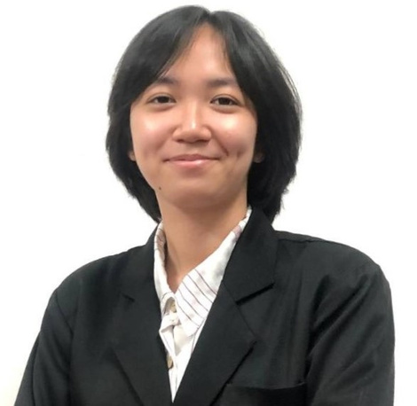

BCI3302
23/24-II
PROJECT MANAGEMENT & PROFESSIONAL PRACTICE
IK SHIM A/P EH FHOT
CA21093
01126280331
ikshim08@gmail.com
Cluster:

Slide 2







02
PERSONAL
INFO
HOMETOWN
HOBBY
FAVOURITE MOVIE
Play
Capture the
Flag
A.I. Artificial Intelligence
Kuantan, Pahang

Slide 3



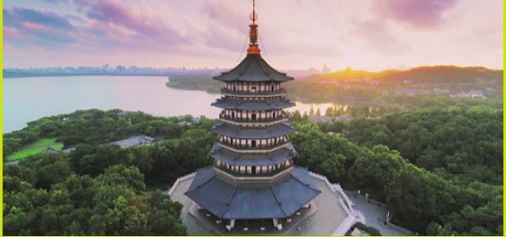

03
PPROPOSED SYSTEMS/APPS
PAGODA
An AI-Powered Hotel Management App

Slide 4





04
PROJECT MISSION
PAGODA
To develop a mobile app called Pagoda within a year that optimize hotel management with AI, streamlining booking operations, and enhancing tourists' experience in Malaysia.

Slide 5



05
PROJECT TIMELINE, COST & STAKEHOLDERS
Period/time
Stakeholders
12 Months
Hotel Owners
Hotel Staffs
Guests/Tourists
Project Manager
Development Team
Cost
RM 500,000.00

Slide 6

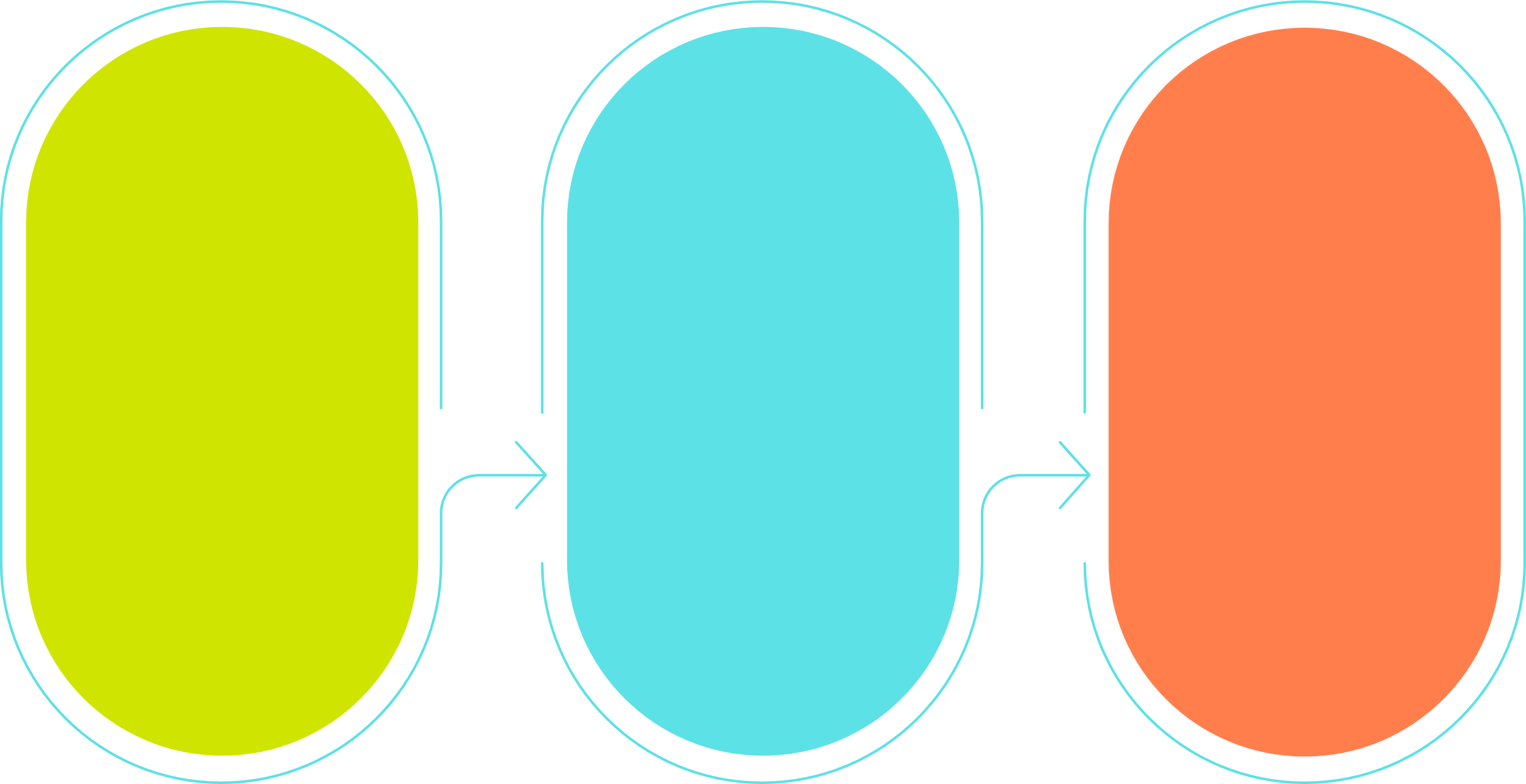
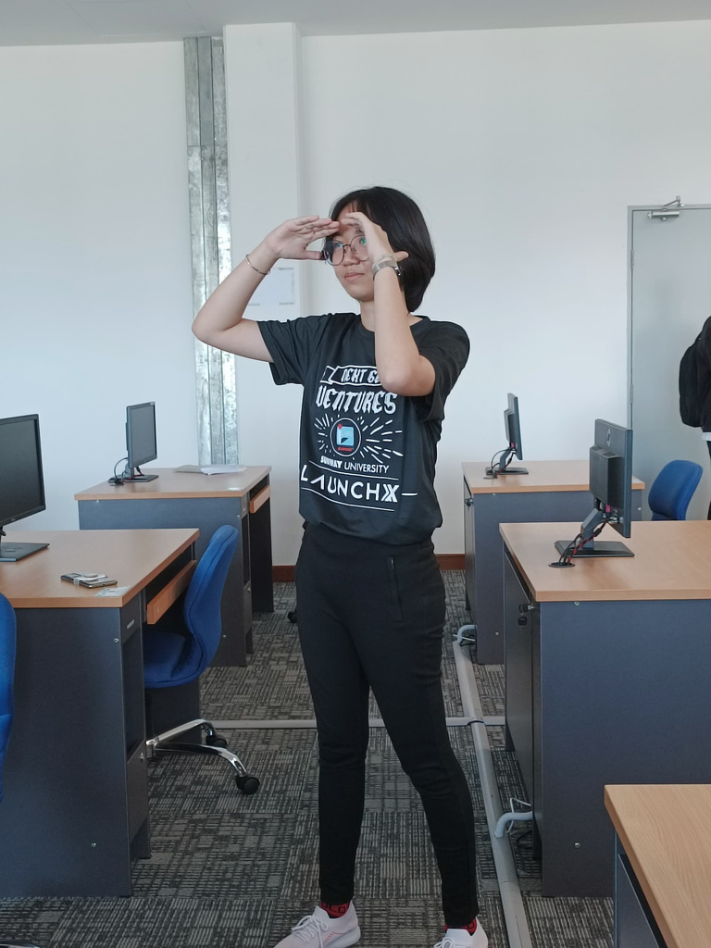
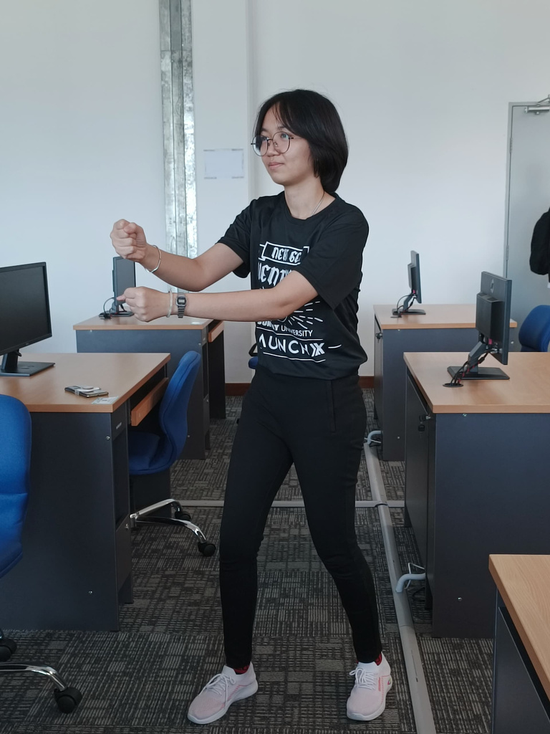
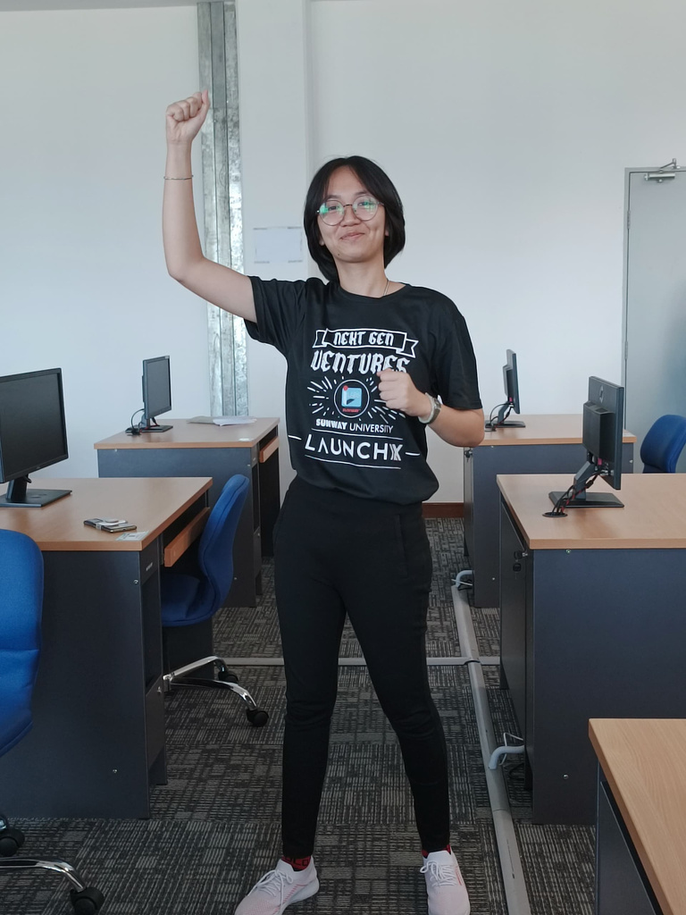
06
WAR CRY & CHEERS

Slide 7

5 STAKEHOLDERS
07
WHY THEY INVOVOLVE IN THIS PROJECT
reason
Hotel Owners
Hotel Staffs
Guests/Tourists
Project Manager
Development Team

